Slide 1
Problem #1
A = [3, 2, 6, 1, 8, 11]
Goal :
odd numbers at odd indices
odd numbers should be in decreasing order
even numbers at even indices
even numbers should be in increasing order
A= [2,11 ,6 ,3, 8, 1 ]

Slide 2
Problem #2
A = [4, 9, 1, 5]
B = [1, 3, 0, 2]
A = [4, 9, 1, 5]
Key=4
Value=0
KV pair = [(4, 0), (9, 1), (1,2), (5, 3)]

Slide 3
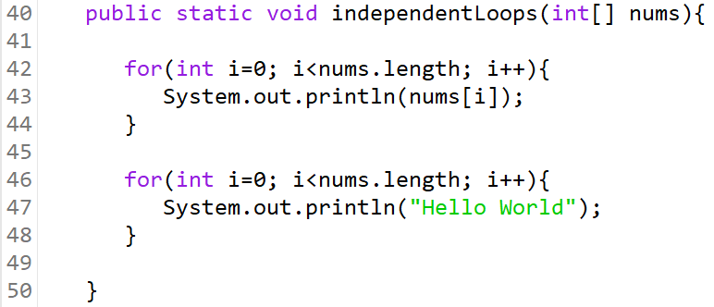
Linear Time -- O(n)
The above algorithm has two independent loops, both loops will iterate n number of times, where n is the size of nums.
So the complexity of this algorithm is said to be O(2n) but as we know by now we drop constants so this algorithm just runs in O(n).

